Slide 1
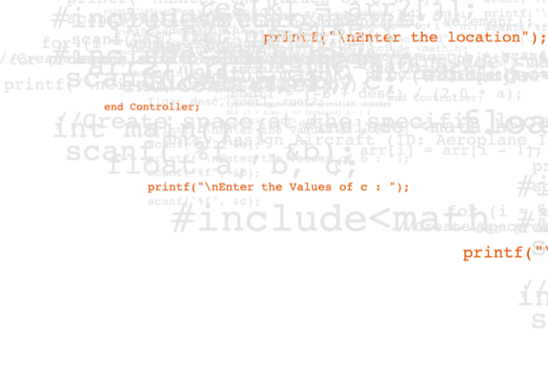

FS Engineering Metrics
EIM / APPS - Release Metrics: 2021
Overview of QA facilitation of Release sign off process
Release metrics collated for the last seven major EIM Product deliveries – including V8.2
Notes:
Introduction

Slide 2
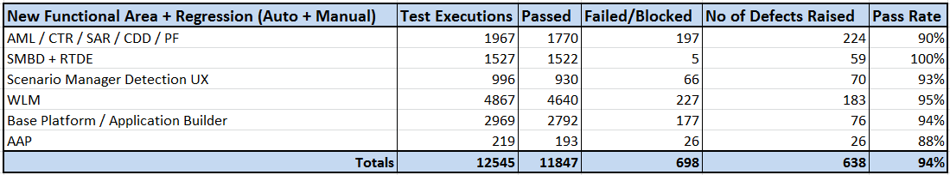
NR V8.2 – GA November 2020
NetReveal 8.2 Key Release Metrics
NetReveal V8.2 release delivered on schedule and with the scope of content as agreed with Product Management and Senior Management.
Key QA release metrics;
1619 new test cases were written for new features in NetReveal 8.2 and defect verification. All tests were executed over Sprints cycles in the NetReveal 8.2 development lifecycles.
10707 regression test executions in the same NetReveal 8.2 timeframe by the Scrum teams.
There is significantly higher ratio of regression test executions when compared to new test case execution . Reasons for this pattern are;
The volume of test automation continues to grow and allows for greater volumes of regression test execution with each subsequent NR Product (EIM/APPS/SMBD/RTDE) release.
QA is consistently converting ‘new’ test cases from prior releases into a growing current regression test suite.
QA testing for V8.2 also focused on running multiple regression cycles on new technology stacks (Postgres, Tomcat, etc.).
0 EIM NetReveal 8.2 P1 or P2 severity issues remained open on the release date;

Slide 3
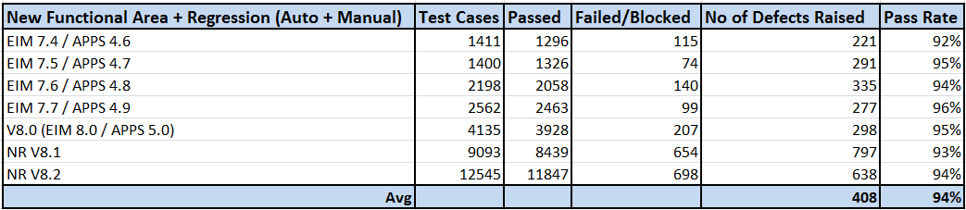
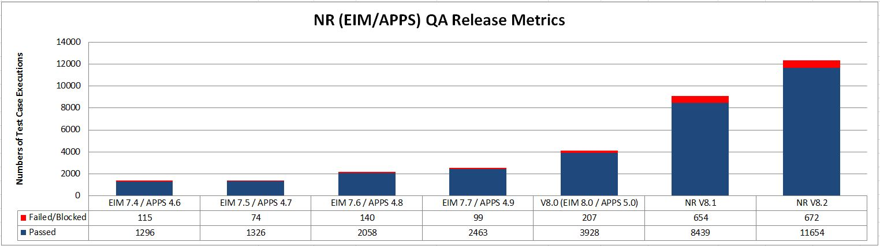
NR (EIM /APPS) – Release Metric Comparison
EIM/APPS QA Release Metrics for last seven Product releases
The volume of QA test cases being executed per release is increasing in line with an ongoing growth in automated test regression.
Pass rates have been consistent over the last seven NR (EIM/APPS) Product releases.
Defect volumes are spread across product modules and 50%+ are rated P5 (uncategorised).

Slide 4
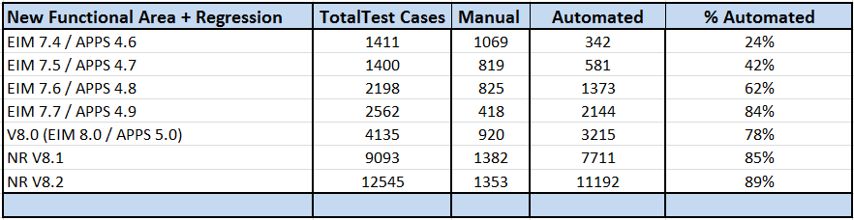
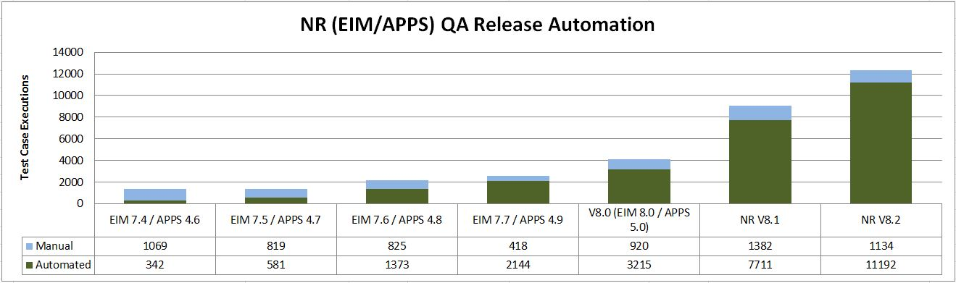
NR (EIM /APPS) – Automation Metric Comparison
EIM/APPS Increase in QA test automation over last six Product releases
Since mid 2017, technologies such as Java Selenium have steadily increased the volume of QA test automation.
The V8.2 QA process still involves an element of manual testing, for example in visual verification, that is still difficult to automate.

Slide 5
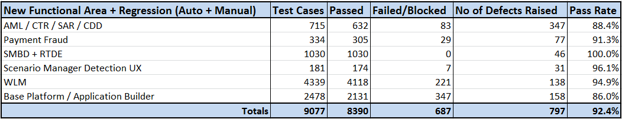
NR V8.1 – GA February 2020
NetReveal 8.1 Key Release Metrics
NetReveal Compliance and Payment Fraud V8.1 release delivered on schedule and with the scope of content as agreed with Product Management and Senior Management.
Key QA release metrics;
1128 new test cases were written for new features in NetReveal 8.1 and defect verification. All tests were executed over Sprints cycles in the NetReveal 8.1 development lifecycles.
7949 regression tests were executed in the same NetReveal 8.1 timeframe by the Scrum teams.
There continues to be a trend of a significantly higher ratio of regression test executions when compared to new test case execution . Reasons for this pattern are;
The volume of test automation continues to grow and allows for greater volumes of regression test execution with each subsequent NR Product (EIM/APPS/SMBD/RTDE) release.
QA is consistently converting ‘new’ test cases from prior releases into a growing current regression test suite.
QA testing for V8.1 also focused on running multiple regression cycles on new technology stacks (Postgres, Tomcat, etc.).
0 EIM NetReveal 8.1 P1 or P2 severity issues remained open on the release date;

Slide 6
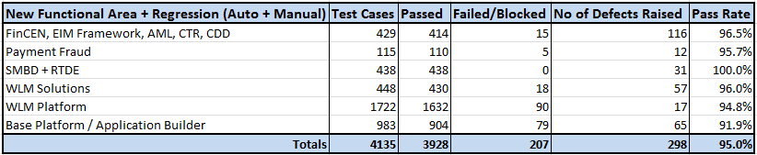
NR V8.0 (EIM 8.0/APPS 5.0)–GA March 2019
V8.0 Key Release Metrics – EIM and APPS Combined for this release
NetReveal Compliance and Payment Fraud V8.0 (EIM platform 8.0/APPS 5.0) release delivered on schedule and with the scope of content as agreed with Product Management and Senior Management.
Key QA release metrics;
392 new test cases were written for new features in EIM 8.0/APPS 5.0 and defect verification. All tests were executed over Sprints cycles in the EIM 8.0/APPS 5.0 development lifecycle.
3743 regression tests were executed in the same EIM 8.0/APPS 5.0 timeframe by the Scrum teams.
There is a noticeably lower ratio of new tests created/executed compared to regression test numbers in previous releases. Reasons for this change are;
The underlying EIM Platform changes did not require new functional tests. Existing regression was extended and executed multiple times of different technology platforms.
The volume of test automation continues to grow and allows for greater volumes of regression test execution with each subsequent NR Product (EIM) release.
WLMS APPS testing also focused on running significant regression on new technology stacks (Postgres, WAS Liberty).
Other solution layer testing, apart from Payment Fraud, spent significant effort on extending existing automated regression tests.
0 EIM 8.0/APPS 5.0 P1 or P2 severity issues remained open on the release date;
On release, 33 P3 issues were open on the EIM 8.0/APPS 5.0 release.

Slide 7
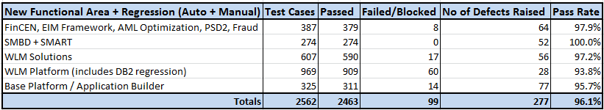
EIM 7.7 / APPS 4.9 – December 2018
Key Release Metrics – EIM and APPS Combined for this release
EIM Platform 7.7 / APPS 4.9 released on schedule and with the scope of content as agreed with Product Management and Senior Management
Key QA release metrics;
784 new test cases were written for new features in EIM 7.7/APPS 4.9 and defect verification. All tests were executed over Sprints cycles in the EIM 7.7/APPS 4.9 development lifecycle.
1778 regression tests were executed in the same EIM 7.7/APPS 4.9 timeframe by the Scrum teams. The higher regression numbers reflect the impact of ongoing cumulative automated regression tests.
3 EIM 7.7/APPS 4.9 P2 severity issues remained open on the release date;
1 – Application Builder already fixed and planned for inclusion in next ‘point’ release, which is likely to be EIM Platform version that ships with APPS 4.9.
1 – EIM Base Platform related to build process and not the release functionality.
1 – WLM Postgres issues being deferred to a later release.
On release, 29 P3 issues were open on the EIM 7.7/APPS 4.9 release.
SM Big Data test activity have also been included in the QA totals in the table below.
The selection of existing test cases in regression testing is based on defect trend analysis from previous APPS releases.

Slide 8
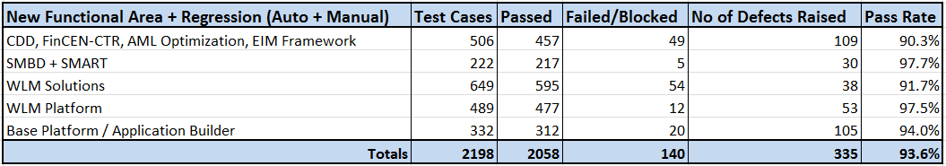
EIM 7.6 / APPS 4.8 – GA June 29th 2018
Key Release Metrics – EIM and APPS Combined for this release
RACI process concluded with all Stakeholder sign off on 28th June 2018 – EIM 7.6 and APPS 4.8 combined release.
EIM Platform 7.6 / APPS 4.8 released on schedule and with the scope of content as agreed with Product Management and Senior Management
Content details published on GEP Confluence, and incorporated into Training VMs made available at end of June 2018.
Key release metrics reviewed in formal RACI process;
1434 new test cases were written for new features in EIM 7.6/APPS 4.8 and defect verification. All tests were executed over Sprints cycles in the EIM 7.6/APPS 4.8 development lifecycle.
764 regression tests were executed in the same EIM 7.6/APPS 4.8 timeframe by the Scrum teams. The higher regression numbers reflect the impact of ongoing cumulative automated regression tests.
3 EIM 7.6 P2 severity issues remained open on the release date. 2 PostGresSQL on Base Platform and 1 WLM issue (non release critical).
On release, 25 P3 issues were open on the EIM 7.6/APPS 4.8 release.
SM Big Data test activity have also been included in the QA totals in the table below.
The selection of existing test cases in regression testing is based on defect trend analysis from previous APPS releases.

Slide 9
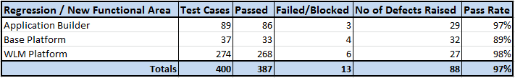
EIM Platform 7.5 – GA December 1st 2017
Key Release Metrics
EIM Platform 7.5 released on schedule on December 1st 2017, with the scope of content as agreed with Product Management and Senior Management
The formal RACI process for EIM 7.5 was included in the APPS 4.7 release and concluded with full APPS Stakeholder sign off on 21st December 2017.
Content details were published on GEP Confluence, and incorporated into APPS 4.7 Training VMs, which were made available at the end of December 2017.
Key release metrics reviewed in formal RACI process;
241 test cases were written for new features in V7.5 and defect verification. All were executed over Sprint cycles in the EIM 7.5 lifecycle.
159 regression test cases were executed in the same V7.5 development timeframe.
Zero V7.5 EIM high severity issues remained open (P1 or P2) on the release date.
On release, 31 P3 issues were open on the EIM 7.5 platform (relating specifically to 7.5).
Post release performance benchmarking scheduled for Q1 2018 (since executed).
EIM 7.5 test case metrics:

Slide 10
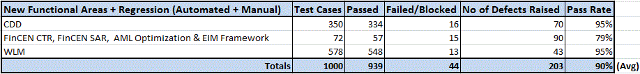
APPS 4.7 – GA December 21st 2017
Key Release Metrics
RACI process concluded with all Stakeholder sign off on 21st December 2017 – included underlying EIM 7.5 Platform release.
APPS 4.7 released on schedule and with the scope of content as agreed with Product Management and Senior Management
Content details published on GEP Confluence, and incorporated into Training VMs made available at end of December 2017.
Key release metrics reviewed in formal RACI process;
687 new test cases were written for new features in APPS 4.7 and defect verification. All tests were executed over Sprints cycles in the APP 4.7 development lifecycle.
313 regression tests were executed in the same APPS 4.7 timeframe by the Scrum teams. Thus, 1000 test cases were run in total for APPS 4.7.
Zero APPS 4.7 high severity issues remained open (P1 or P2) on the release date.
On release, 38 P3 issues were open on the APPS 4.7 release (relating specifically to 4.7).
A growing volume of regression is being continually automated in Selenium and added to the priority regression test suite. For simplicity, the automated and manual regression test numbers have been combined in the tables below.
The selection of existing test cases in regression testing is based on defect trend analysis from previous APPS releases.

Slide 11
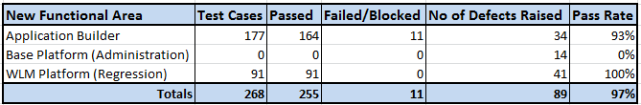
EIM Platform 7.4 – GA June 30th 2017
Key Release Metrics used in the RACI process
EIM Platform 7.4 released on schedule on June 30th 2017, with the scope of content as agreed with Product Management and Senior Management
Formal RACI process for EIM 7.4 was included in the APPS 4.6 release and concluded with full APPS Stakeholder sign off on 31st September 2017.
Content details published on GEP Confluence, and incorporated into APPS 4.6 Training VMs, which were made available at the end of September 2017.
Key release metrics reviewed in formal RACI process;
177 test cases were written for new features and defect verification in V7.4. All were executed over Sprint cycles in the EIM 7.4 lifecycle.
91 automated WLM regression tests were also run in the V7.4 timeframe.
Significant exploratory (ad-hoc) testing practices were introduced into the Sprint cycle – which raised a number of minor defect issues unrelated to the formal (written) test cases.
Zero V7.4 EIM high severity issues remained open (P1 or P2) on the release date.
On release, 33 P3 issues were open on the EIM 7.4 platform (relating specifically to 7.4).
EIM 7.4 test case metrics:

Slide 12

APPS 4.6 – GA September 31st 2017
Key Release Metrics
RACI process concluded with complete Stakeholder sign off on September 31st 2017 – included underlying EIM 7.4 Platform release.
APPS 4.6 released on schedule and with the scope of content as agreed with Product Management and Senior Management.
Content details published on GEP Confluence, and incorporated into Training VMs made available at end of September 2017.
Key release metrics reviewed in formal RACI process;
1143 new test cases were written for; new features in APPS 4.6, application regression, and defect verification. All tests were executed over Sprints cycles in the APP 4.6 lifecycle.
One APPS 4.6 high severity issues remained open (P1 or P2) on the release date. This was in relation to Parameter Optimisation functionality, and it was agreed in the RACI process to address this requirement in an immediate 4.6.1 release timeframe.
On release, 39 P3 issues were open on the APPS 4.6 release (relating specifically to 4.6).
Automated regression testing in Selenium commenced within the APPS 4.6 release and, although relatively low, have been included in the number below.
The selection of existing test cases in regression testing was based on defect trend analysis from previous APPS releases.

